Slide 1
Lecture 10 – Class Review
Yanwen Wang
Sauder School of Business
University of British Columbia
March 2018

Slide 2
Evaluation
Course Evaluation
Peer Evaluation (deadline 4/1 11:59pm)

Slide 3
Course Structure
Introduction to CRM
Acquisition, Retention & Revenue
Loyalty Programs
Recommender System
Multi-Channel
Customer Lifetime Value
Revenue per User
Segmentation
Collaborative Filtering
Multi-channel management
Different CLV Formula Calculation
Retention
Clustering
User-Based Collaborative Filtering
Attribution
Monte Carlo Simulation
Acquisition
Tableau
Survival

Slide 4
Key Points Lecture 2
CLV calculations (formula 1, 2, and 3)
Limitations of CLV formula
Monte Carlo simulations of CLV calculations
Maru Batting Center

Slide 5
Key Points Lecture 3
Linear regressions to model revenue/profit per period
Linear regression model interpretations
Continuous vs categorical variables
Missing value treatment
Interaction effect interpretations

Slide 6
Key Points Lecture 4
Linear logistic model of retention rate
Linear logistic model interpretations
Cumulative Lift Chart & Cumulative Gain Chart
CDNow Recency, Frequency, and Monetary analysis

Slide 7
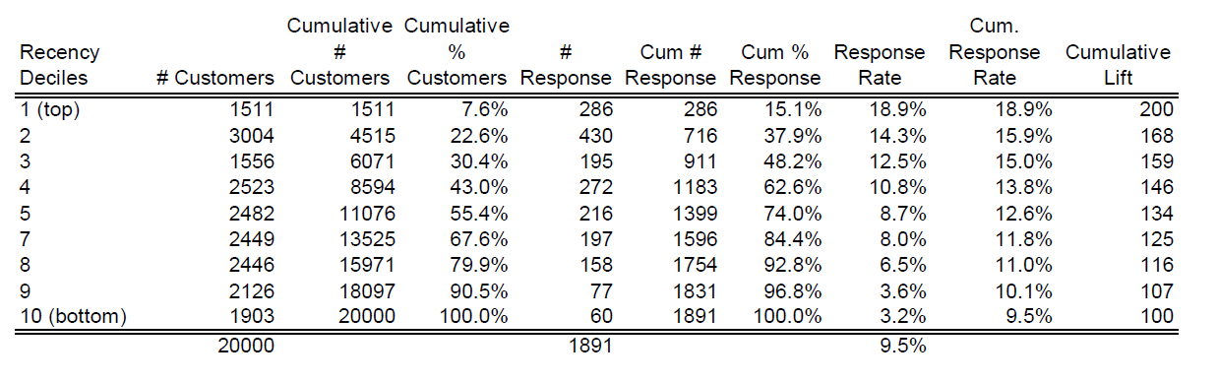
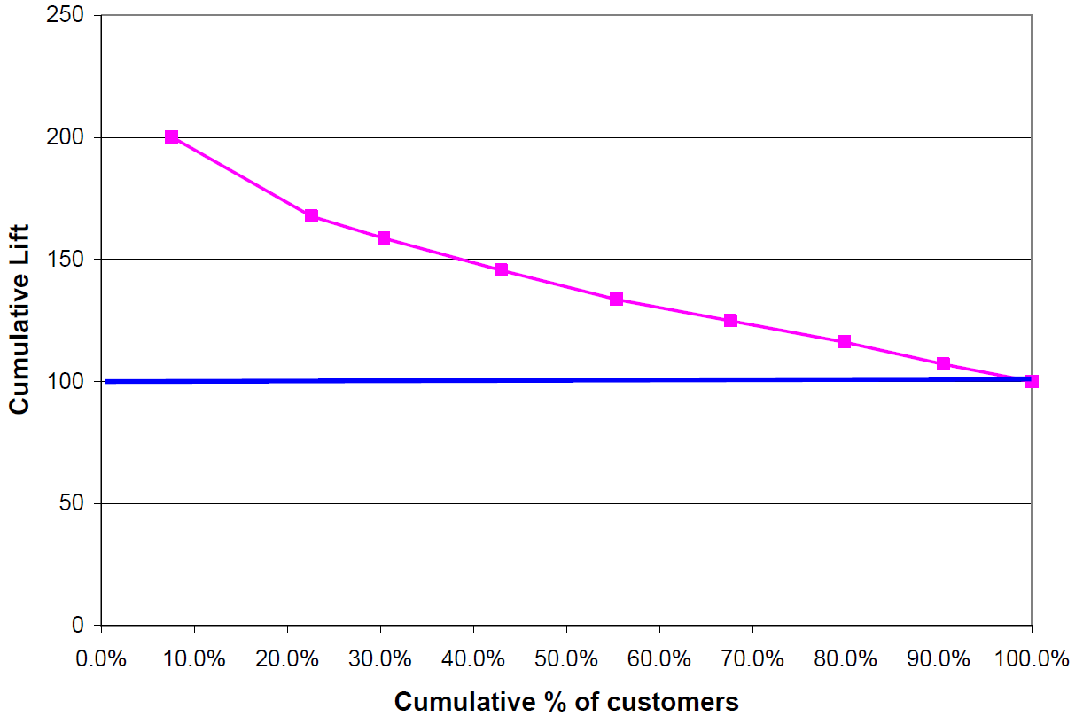
Cumulative Lift Chart

Slide 8
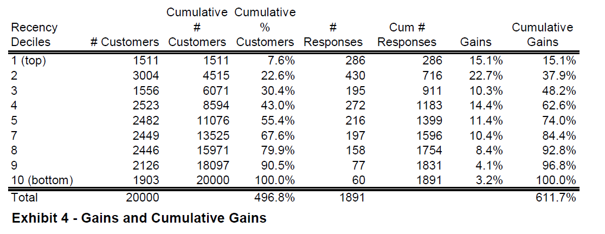
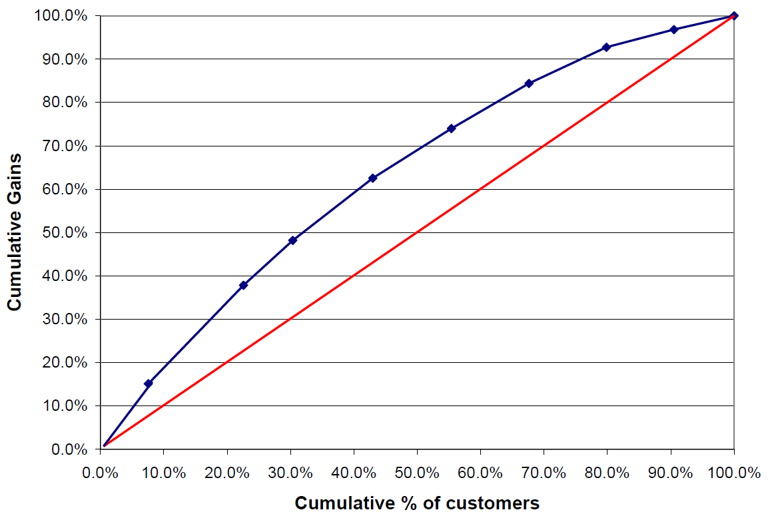
Cumulative Gain Chart

Slide 9
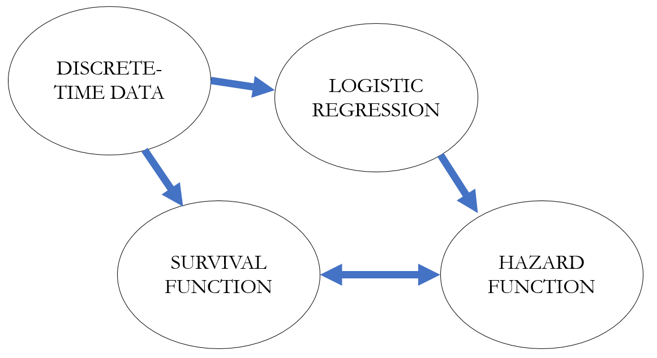
Key Points Lecture 5
Survival probability and hazard probability
Data-based survival curve and hazard curve
Model-based survival curve and hazard curve
Educational Service Case

Slide 10
Key Points Lecture 6
Loyalty Program Reward Valuation
Loyalty Program Cost Consideration
Tableau

Slide 11
Key Points Lecture 7
Select clustering variables
Select clustering method
K-means (Euclidean distance)
SK-means (cosine distance)
Determine the number of clusters
Interpret results and profiling clusters

Slide 12
Key Points Lecture 8
Similarity (distance) measure
Manhattan distance
Euclidean distance
Cosine distance
Pearson correlation
User-based collaborative filtering
Understand the five steps conceptually
No R coding requirement of user-based collaborative filtering for exams

Slide 13
Key Points Lecture 9
Multi-Channel Evaluation Metrics
First click metric
Last click metric
Linear click metric
Markov Chain based metric

Slide 14
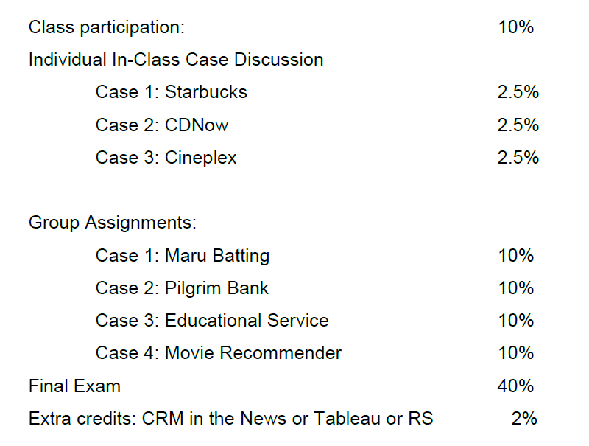
Assignments Overview

Slide 15
Final Exam 40%
Approximately 40 multiple choice questions
2 hours April 4th 10:30-12:30pm HA133
There will be in total three to four scenarios
You will be given data sets for each scenario
Write R-codes
Which multiple choice answer is the most appropriate answer
R codes requirements within the range of your group and individual assignments

Slide 16
Final Exam 40%
Bring laptop with power cord or 2-hour lasting battery
Bring your student ID
You cannot leave the Rstudio environment on your laptop for the final
You can have R-script cheat sheets with as many notes as you want on it
In another way, you can have R-scripts of previous assignments open
However, you are not allowed to use the Internet or class slides
Two invigilators will monitor the screens at the back of the classroom

Slide 17
Final Exam Example Question
See the doc on Connect

Slide 18
Bonus Point Individual Assignments
CRM in the news (evaluated on CRM business practices)
Tableau AirBnB (evaluated on Tableau visualization)
Movie Recommender System (evaluated on R coding)
Due April 1st 11:59pm

